Slide 1

Introduction to Strimzi
Mateusz Dymiński

Slide 2
Strimzi
What are the problems which Strimzi solves
Definition
Concept
Examples

Slide 3
What are the problems which Strimzi solves
Kafka upgrade
Initial deployment
Manage ZooKeeper
Replacing brokers
Topic partition rebalancing
Decommissioning or adding brokers

Slide 4
Strimzi
An operator-based Kafka on Kubernetes project

Slide 5
Strimzi
Strimzi is an open source operator-based Apache Kafka project for Kubernetes and OpenShif
Announced Feb 25th, 2018
Evolved from non-operator project known as Barnabas by Paolo Patierno, Red Hat
Part of Red Hat Developer Program
“Streams” component of Red Hat AMQ, a commercial product of messaging technologies by Red Hat

Slide 6
Strimzi
Project details:
Apache Kafka project for Kubernetes and OpenShift
Licensed under Apache License 2.0
Web site: http://strimzi.io/
GitHub: https://github.com/strimzi
Slack: strimzi.slack.com
Mailing list: strimzi@redhat.com
Twitter: @strimziio

Slide 7
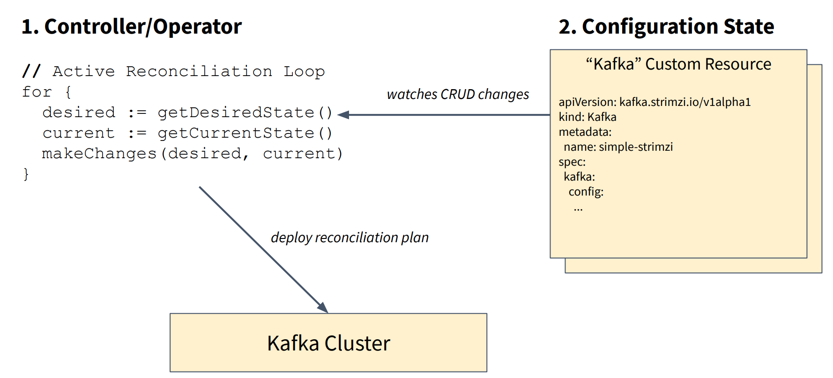
Strimzi – Operator Pattern
Source: https://www.slideshare.net/Lightbend/running-kafka-on-kubernetes-with-strimzi-for-realtime-streaming-applications

Slide 8
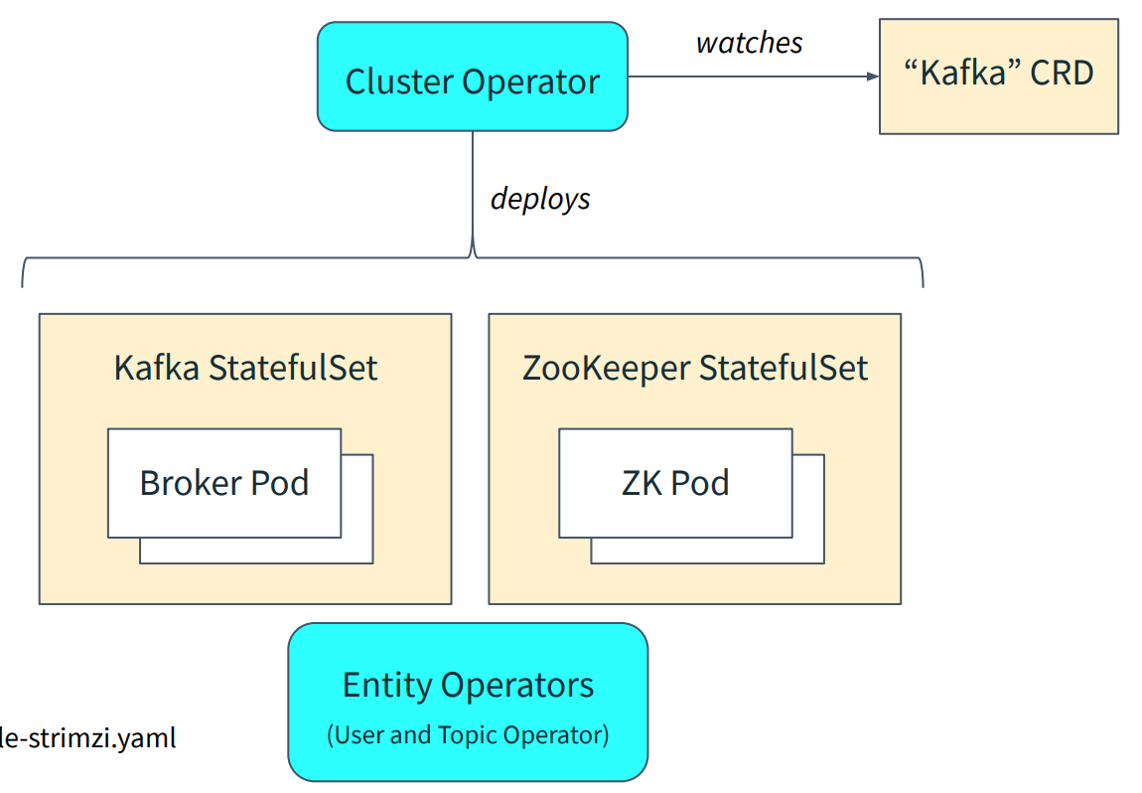
Strimzi – Cluster Operator
Source: https://www.slideshare.net/Lightbend/running-kafka-on-kubernetes-with-strimzi-for-realtime-streaming-applications

Slide 9
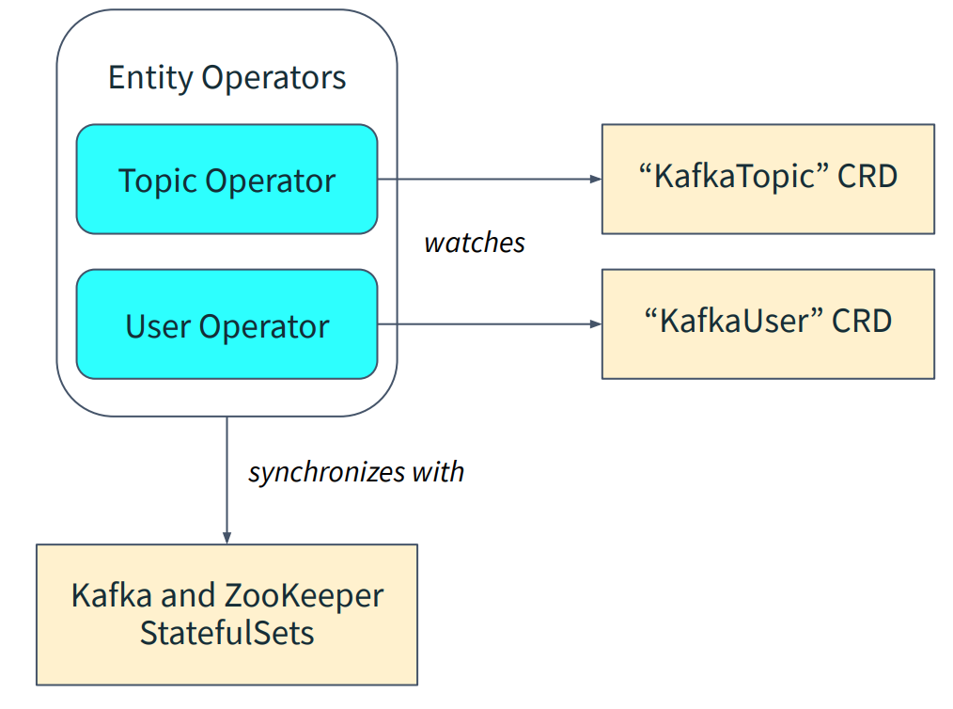
Strimzi – User and Topic Operators
Source: https://www.slideshare.net/Lightbend/running-kafka-on-kubernetes-with-strimzi-for-realtime-streaming-applications

Slide 10
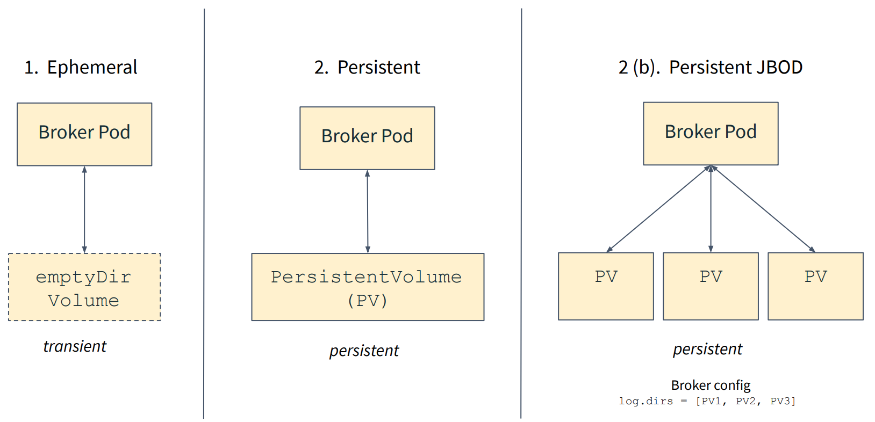
Strimzi – Storage Modes
Source: https://www.slideshare.net/Lightbend/running-kafka-on-kubernetes-with-strimzi-for-realtime-streaming-applications

Slide 11
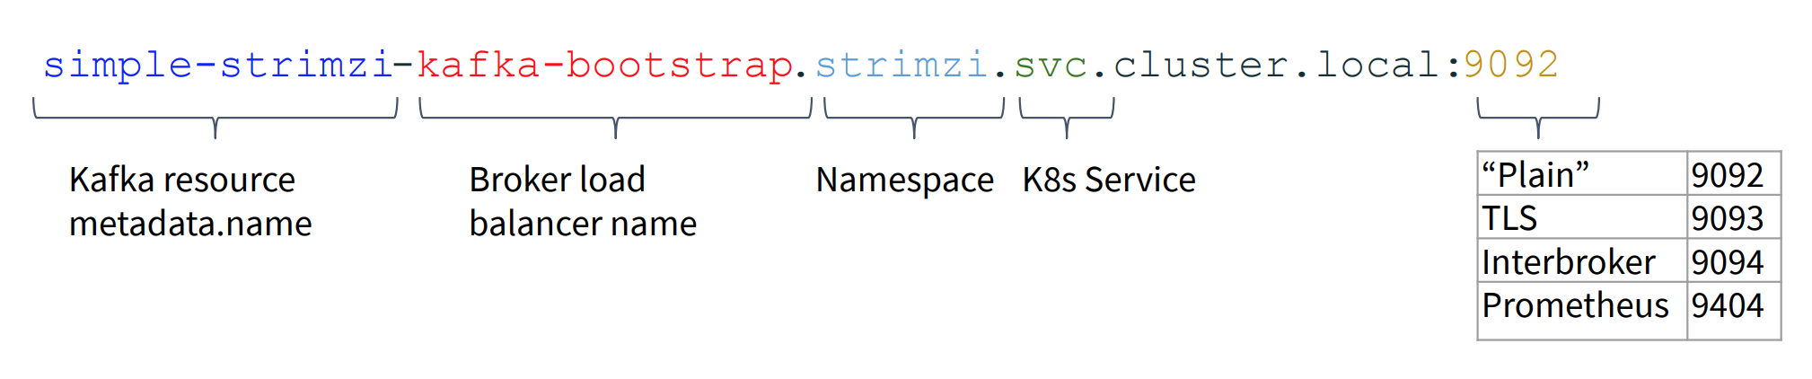
Strimzi – Connecting Clients
Source: https://www.slideshare.net/Lightbend/running-kafka-on-kubernetes-with-strimzi-for-realtime-streaming-applications

Slide 12

Exercise 1 Install Kafka

Slide 13
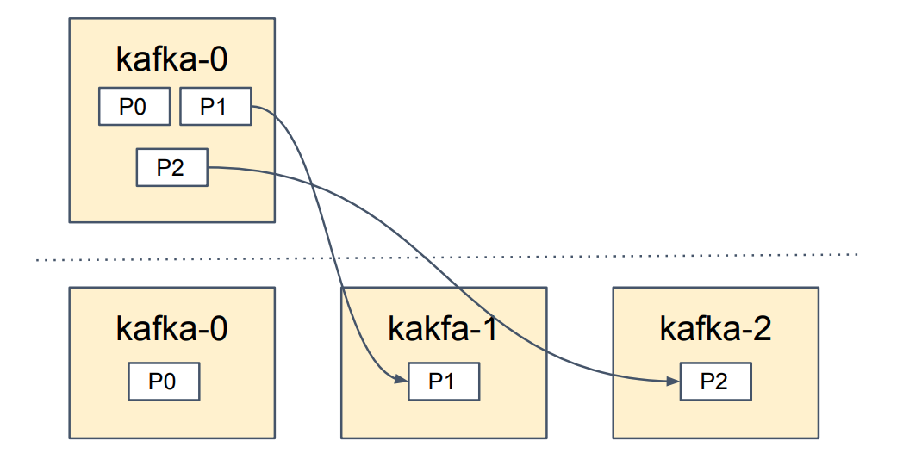
Scaling Brokers Up
Increase replica count spec.kafka.replicas
Reassign partitions: ./bin/kafka-reassign-partitions.sh
Source: https://www.slideshare.net/Lightbend/running-kafka-on-kubernetes-with-strimzi-for-realtime-streaming-applications

Slide 14
Exercise 2 Scaling Kafka Brokers

Slide 15
Rolling Configuration Update
Rolling Configuration Process:
Watched Kafka resource change
Apply new config to Kafka StatefulSet spec
Starting from pod 0, delete the pod and allow the StatefulSet to recreate it
Kafka pod will generate new broker.config
Kafka is started
Wait until the readiness check is good.
Repeat from step 3 for the next pod
Source: https://www.slideshare.net/Lightbend/running-kafka-on-kubernetes-with-strimzi-for-realtime-streaming-applications

Slide 16
Exercise 3 Kafka Configuration

Slide 17
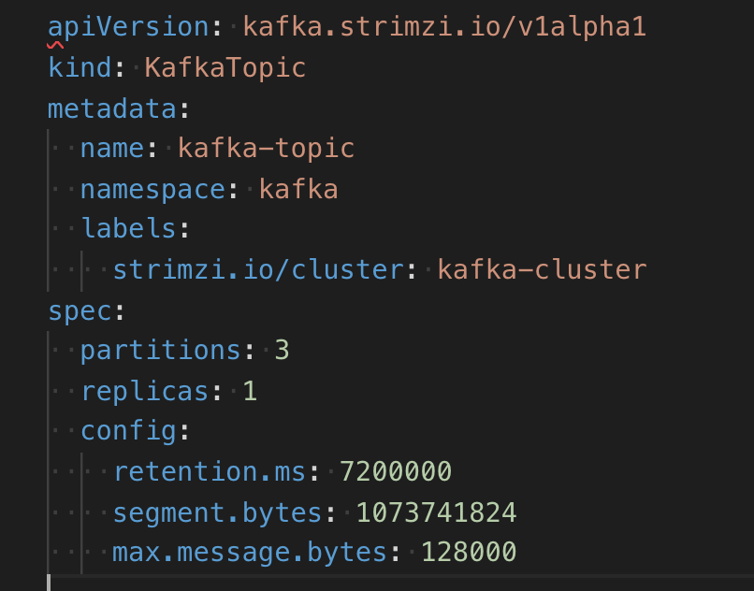
Kafka Topic Configuration
All options: https://kafka.apache.org/documentation/#topicconfigs
We can do that manually:
bin/kafka-configs.sh --zookeeper localhost:2181 --entity-type topics --entity-name kafka-topic --alter --add-config max.message.bytes=128000
Or with Strimzi help

Slide 18
Exercise 4 Topic Configuration

Slide 19

Kafka for HA

Slide 20
Kafka Configuration for High Availability and Consistency
Replication Factor
Acknowledgements
Retries
Minimum In-sync Replicas
Kafka MirrorMaker

Slide 21
Replication Factor
The default replication factor for new topics is one. For high availability production systems, recommendation is to set the replication factor to at least three. This requires at least three Kafka brokers.
replication.factor: 3
default.replication.factor: 3
offsets.topic.replication.factor: 3

Slide 22
Acknowledgements
When writing or configuring a Kafka producer, you can choose how many replicas commit a new message before the message is acknowledged using the acks property.
Values:
Set acks to 0 (immediately acknowledge the message without waiting for any brokers to commit)
1 (acknowledge after the leader commits the message),
all (acknowledge after all in-sync replicas are committed) according to your requirements. Setting acks to all provides the highest consistency guarantee at the expense of slower writes to the cluster.

Slide 23
Retries
Configure retries on your producers. The default value is 3, which is often too low.
The right value will depend on your application; for applications where data-loss cannot be tolerated, consider Integer.MAX_VALUE (effectively, infinity).

Slide 24
Minimum In-sync Replicas
You can set the minimum number of in-sync replicas (ISRs) that must be available for the producer to successfully send messages to a partition using the min.insync.replicas setting. If min.insync.replicas is set to 2 and acks is set to all, each message must be written successfully to at least two replicas. This guarantees that the message is not lost unless both hosts crash.
It also means that if one of the hosts crashes, the partition is no longer available for writes.

Slide 25
Kafka MirrorMaker
Kafka mirroring enables maintaining a replica of an existing Kafka cluster.
More about MirrorMaker -> Later ☺

Slide 26
Kafka HA on Kubernetes best practicies
Make sure Kafka pods are not scheduled on the same node as other performance intensive applications
Make sure Kafka pods are scheduled on the nodes with the most suitable hardware
Use nodes which are dedicated to Kafka only
Source: https://strimzi.io/2018/07/30/running-kafka-on-dedicated-nodes.html

Slide 27
Strimzi configuration for High Availability and Consistency
Pod Affinity
Pod Anty-Affinity
Node Affinity
Dedicated Nodes
Source: https://strimzi.io/2018/07/30/running-kafka-on-dedicated-nodes.html

Slide 28
Pod Affinity and Anty-Affinity
Pod Affinity and Anty-Affinity is a Kubernetes feature which allows you to specify constraints for pod scheduling.
It allows users to specify whether the pod should be scheduled on the same node (affinity) as another pod or on a different node (anti-affinity).
Strimzi supports pod affinity for Kafka, Zookeeper, Kafka Connect and Topic Operator. You can use it to specify the pods which should never run on the same node as Kafka pods.
By affinity property.
Source: https://strimzi.io/2018/07/30/running-kafka-on-dedicated-nodes.html

Slide 29
Pod Anty-Affinity Example
apiVersion: kafka.strimzi.io/v1alpha1
kind: Kafka
metadata:
name: kafka-cluster
spec:
kafka:
...
affinity:
podAntiAffinity:
requiredDuringSchedulingIgnoredDuringExecution:
- labelSelector:
matchExpressions:
- key: application
operator: In
values:
- postgresql
- mongodb
topologyKey: "kubernetes.io/hostname"
...
zookeeper:
...
It will require Kubernetes to schedule the Kafka pods on nodes where there are no other pods with labels application=postgresql or application=mongodb.
The topologyKey field specifies that the pods matching the selector should not be sharing the same hostname - which means they will be scheduled on different nodes.
Source: https://strimzi.io/2018/07/30/running-kafka-on-dedicated-nodes.html

Slide 30
Node Affinity
cluster consists of many different types of nodes – some of them might be faster or slower
To schedule workloads onto specific nodes, Kubernetes has a feature called node affinity.
Node affinity allows you to create a scheduling constraint for the node on which the pod will be scheduled.
You can either use it for the built-in node label such as beta.kubernetes.io/instance-type. Or you can use your own labels to select the right node.
Node affinity can be also specified in the affinity field of our custom resources for Kafka, Zookeeper and Kafka Connect.
Source: https://strimzi.io/2018/07/30/running-kafka-on-dedicated-nodes.html

Slide 31
Node Affinity Example
apiVersion: kafka.strimzi.io/v1alpha1
kind: Kafka
metadata:
name: kafka-cluster
spec:
kafka:
...
affinity:
nodeAffinity:
requiredDuringSchedulingIgnoredDuringExecution:
nodeSelectorTerms:
- matchExpressions:
- key: node-type
operator: In
values:
- fast-network
...
zookeeper:
...
Kafka pods will be scheduled only on nodes whose node-type label is equal to fast-network.
Source: https://strimzi.io/2018/07/30/running-kafka-on-dedicated-nodes.html

Slide 32
Dedicated Nodes
Pod affinity is a great way to influence pod scheduling, but it’s not enough entirely prevent the noisy neighbour problem.
With dedicated nodes you can make sure that there will be only Kafka pods and system services sharing the node.
There will be no other pods scheduled on such machine which could affect or disturb the performance of the Kafka brokers.
To create a dedicated node, you have to first taint it.
Taints are a feature of nodes which can be used to repel pods.
Source: https://strimzi.io/2018/07/30/running-kafka-on-dedicated-nodes.html

Slide 33
Dedicated Nodes - example
$ kubectl taint nodes ip-10-0-0-124.ec2.internal dedicated=Kafka:NoSchedule
node "ip-10-0-0-124.ec2.internal" tainted
The taint has always has a key, value and effect. In the example above, the key is dedicated, the value is kafka and the effect is NoSchedule
Once the taint and the label are set, we can deploy the Kafka cluster.
$ kubectl label nodes ip-10-0-0-124.ec2.internal dedicated=Kafka
node "ip-10-0-0-124.ec2.internal" labeled
Source: https://strimzi.io/2018/07/30/running-kafka-on-dedicated-nodes.html

Slide 34
Dedicated Nodes - example
apiVersion: kafka.strimzi.io/v1alpha1
kind: Kafka
metadata:
name: kafka-cluster
spec:
kafka:
...
tolerations:
- key: "dedicated"
operator: "Equal"
value: "Kafka"
effect: "NoSchedule"
affinity:
nodeAffinity:
requiredDuringSchedulingIgnoredDuringExecution:
nodeSelectorTerms:
- matchExpressions:
- key: dedicated
operator: In
values:
- Kafka
...
zookeeper:
...
This will make sure that only the Kafka pods will be running on the dedicated nodes.
Source: https://strimzi.io/2018/07/30/running-kafka-on-dedicated-nodes.html

Slide 35

Kafka Log Compaction

Slide 36
Kafka Log Compaction
With a compacted log, the log has head and tail. The head of the compacted log is identical to a traditional Kafka log. New records get appended to the end of the head.
All log compaction works at the tail of the log. Only the tail gets compacted. Records in the tail of the log retain their original offset when written after being rewritten with compaction cleanup.
Log compaction will never re-order messages, just remove some.
Partition offset for a message never changes.
Source: http://cloudurable.com/blog/kafka-architecture-log-compaction/index.html

Slide 37
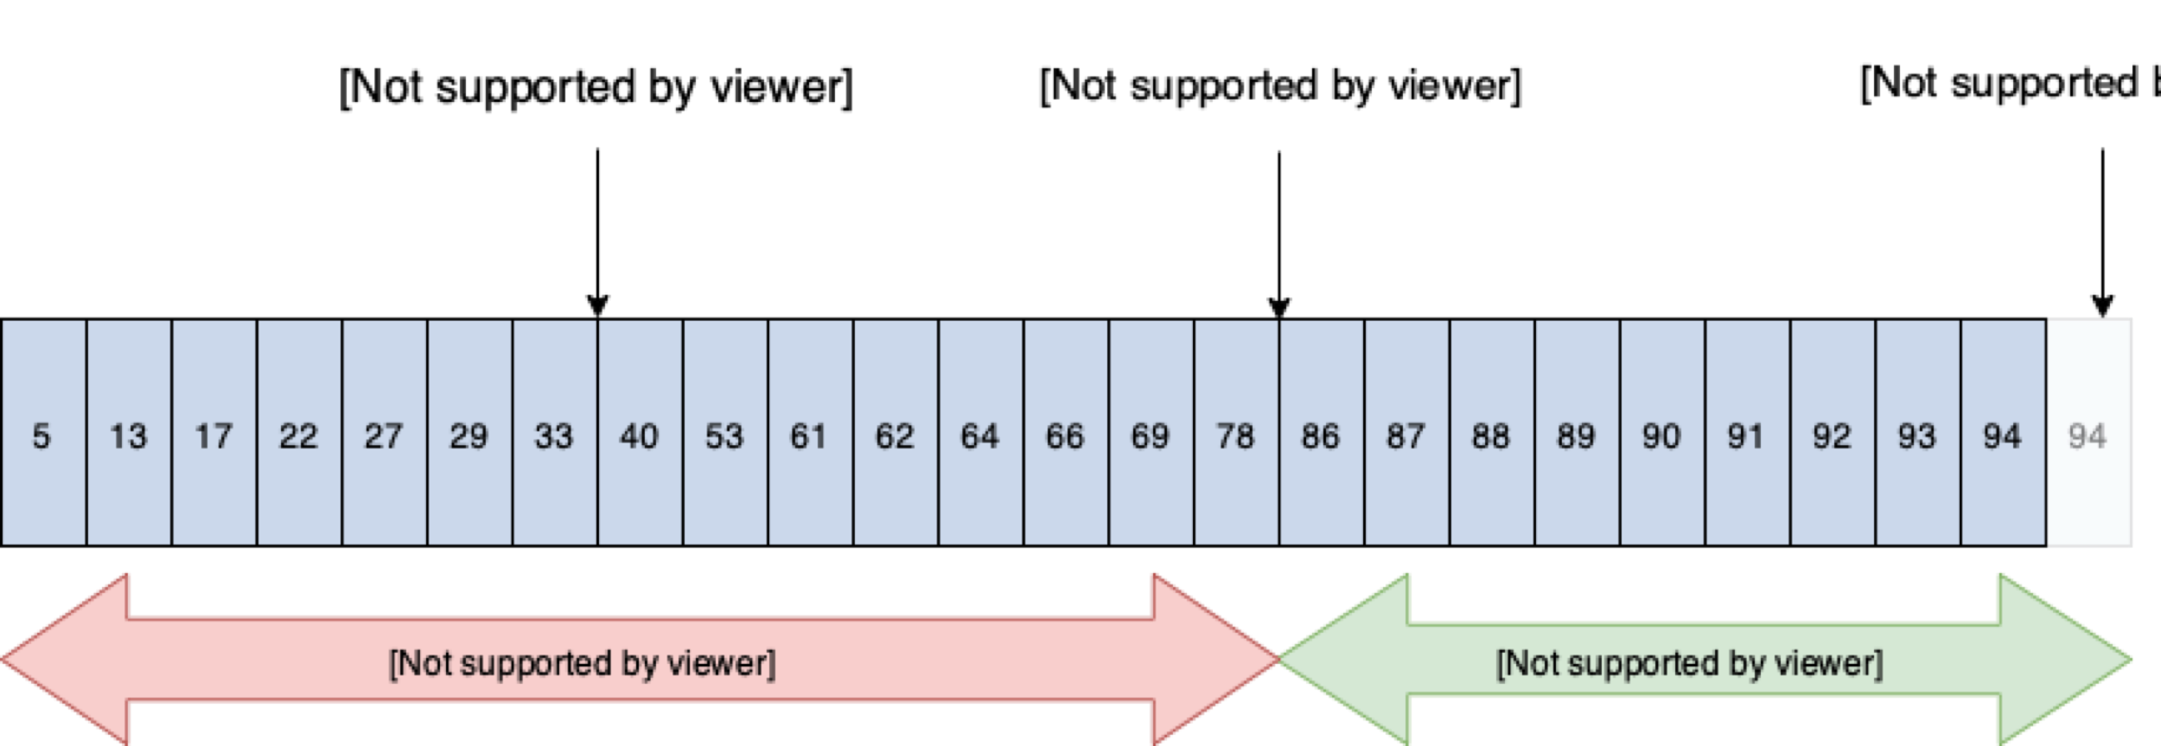
Kafka Log Compaction
Source: http://cloudurable.com/blog/kafka-architecture-log-compaction/index.html

Slide 38
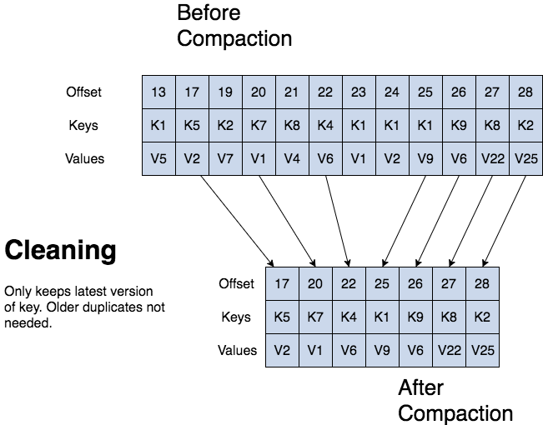
Kafka Log Compaction
Source: http://cloudurable.com/blog/kafka-architecture-log-compaction/index.html

Slide 39
Kafka Log Compaction – Topic Configuration
To turn on compaction for a topic use topic config log.cleanup.policy=compact.
To set delay to start compacting records after they are written use topic config log.cleaner.min.compaction.lag.ms. Records won’t get compacted until after this period. The setting gives consumers time to get every record.
Source: http://cloudurable.com/blog/kafka-architecture-log-compaction/index.html

Slide 40
Exercise 5 Log Compaction

Slide 41

Kafka Monitoring

Slide 42
Kafka Monitoring
Options:
https://github.com/linkedin/kafka-monitor – Kafka Monitor
FileBeat + Kibana
Cruise Control
Burrow
https://prometheus.io/ - Prometheus + Grafana
External tools like:
Datadog
Splunk etc.

Slide 43
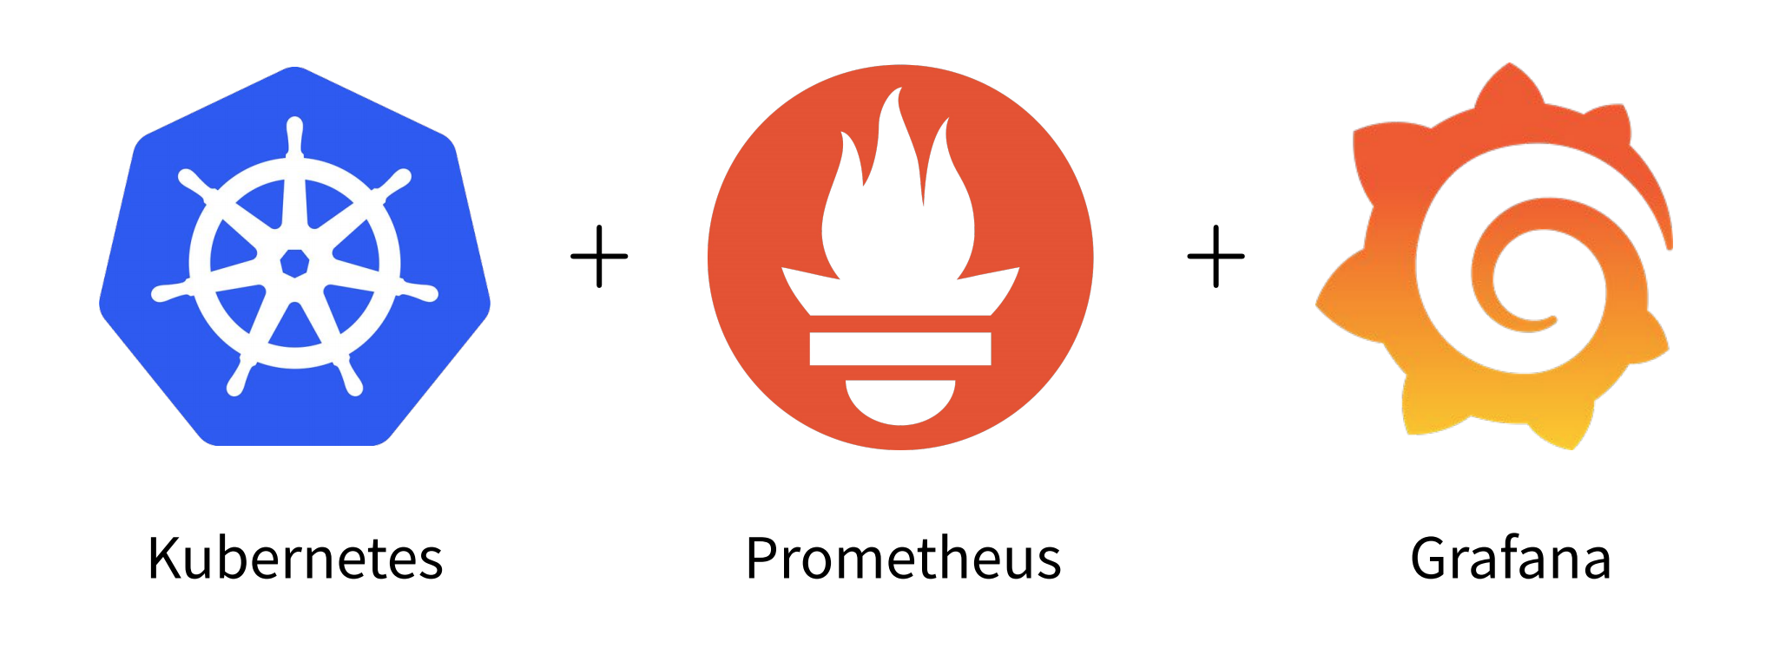
Kafka Monitoring
Source: https://www.slideshare.net/Lightbend/running-kafka-on-kubernetes-with-strimzi-for-realtime-streaming-applications

Slide 44
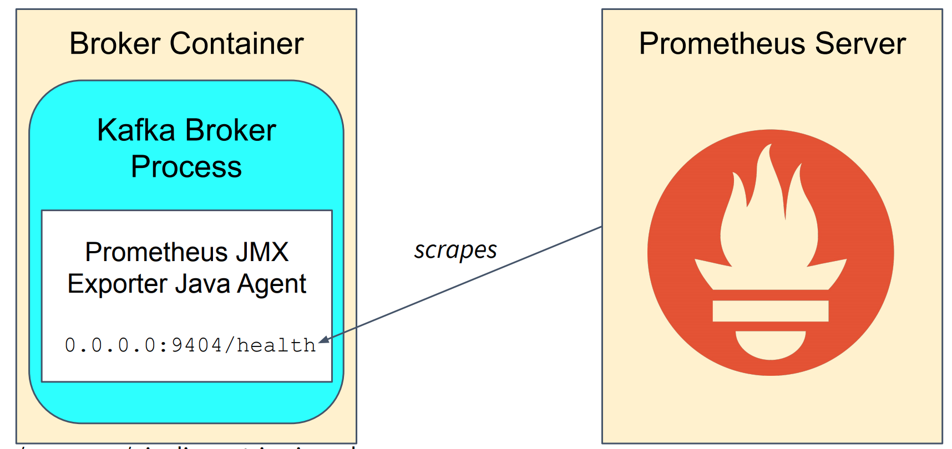
Kafka Monitoring
Strimzi exposes a Prometheus Health Endpoint with Prometheus JMX Exporter
Source: https://www.slideshare.net/Lightbend/running-kafka-on-kubernetes-with-strimzi-for-realtime-streaming-applications

Slide 45
Key Metrics to Monitor
Tree families of metrics:
Kafka Broker metrics
JVM metrics
Host/server metrics

Slide 46
Key Metrics to Set Alerts
kafka.server:type=ReplicaManager,name=UnderReplicatedPartitions
Number of under-replicated partitions (| ISR | < | all replicas |). Alert if value is greater than 0.
kafka.controller:type=KafkaController,name=OfflinePartitionsCount
Number of partitions that don’t have an active leader and are hence not writable or readable. Alert if value is greater than 0.
kafka.controller:type=KafkaController,name=ActiveControllerCount
Number of active controllers in the cluster. Alert if value is anything other than 1.

Slide 47
Key Metrics to Monitor
kafka.server:type=BrokerTopicMetrics,name=MessagesInPerSec
Aggregate incoming message rate.
kafka.server:type=BrokerTopicMetrics,name=BytesInPerSec
Aggregate incoming byte rate.
kafka.server:type=BrokerTopicMetrics,name=BytesOutPerSec
Aggregate outgoing byte rate.
kafka.network:type=RequestMetrics,name=RequestsPerSec,request={Produce|FetchConsumer|FetchFollower}
Request rate.

Slide 48
Key Metrics to Monitor
kafka.log:type=LogFlushStats,name=LogFlushRateAndTimeMs
Log flush rate and time.
kafka.controller:type=ControllerStats,name=LeaderElectionRateAndTimeMs
Leader election rate and latency.
kafka.controller:type=ControllerStats,name=UncleanLeaderElectionsPerSec
Unclean leader election rate.
kafka.server:type=ReplicaManager,name=PartitionCount
Number of partitions on this broker. This should be mostly even across all brokers.

Slide 49
Key Metrics to Monitor
kafka.server:type=ReplicaManager,name=LeaderCount
Number of leaders on this broker. This should be mostly even across all brokers. If not, set auto.leader.rebalance.enable to true on all brokers in the cluster.
kafka.server:type=ReplicaManager,name=IsrShrinksPerSec
If a broker goes down, ISR for some of the partitions will shrink. When that broker is up again, ISR will be expanded once the replicas are fully caught up. Other than that, the expected value for both ISR shrink rate and expansion rate is 0.
kafka.server:type=ReplicaManager,name=IsrExpandsPerSec
When a broker is brought up after a failure, it starts catching up by reading from the leader. Once it is caught up, it gets added back to the ISR.
kafka.server:type=ReplicaFetcherManager,name=MaxLag,clientId=Replica
Maximum lag in messages between the follower and leader replicas. This is controlled by the replica.lag.max.messages config.

Slide 50
Key Metrics to Monitor
kafka.server:type=FetcherLagMetrics,name=ConsumerLag,clientId=([-.\w]+),topic=([-.\w]+),partition=([0-9]+)
Lag in number of messages per follower replica. This is useful to know if the replica is slow or has stopped replicating from the leader.
kafka.network:type=RequestMetrics,name=TotalTimeMs,request={Produce|FetchConsumer|FetchFollower}
Total time in ms to serve the specified request.
kafka.server:type=DelayedOperationPurgatory,delayedOperation=Produce,name=PurgatorySize
Number of requests waiting in the producer purgatory. This should be non-zero acks=-1 is used on the producer.
kafka.server:type=DelayedOperationPurgatory,delayedOperation=Fetch,name=PurgatorySize
Number of requests waiting in the fetch purgatory. This is high if consumers use a large

Slide 51
Kafka Monitoring – best practicies
Configure Alerts
Don’t forget monitor Zookeeper
Don’t forget to monitor Consumer and Producer metrics

Slide 52
Kafka Monitoring – best practicies
Configure Alerts
Don’t forget monitor Zookeeper
Don’t forget to monitor Consumer and Producer metrics
Collect logs and store them in ElasticSearch or other log aggregator
All important metrics and its description:
https://docs.confluent.io/3.2.2/kafka/monitoring.html#server-metrics

Slide 53
Key Metrics to Monitor - materials
Articles:
https://www.datadoghq.com/blog/monitoring-kafka-performance-metrics/
https://docs.confluent.io/current/kafka/monitoring.html

Slide 54
Exercise 6 Setting up Kafka Monitoring

Slide 55

Kafka Troubleshooting and Debugging

Slide 56
Troubleshooting and Debugging
Use Grafana Dashboards
Logs
Consumer lag
Be aware of quotas

Slide 57
Exercise 7 Troubleshooting

Slide 58
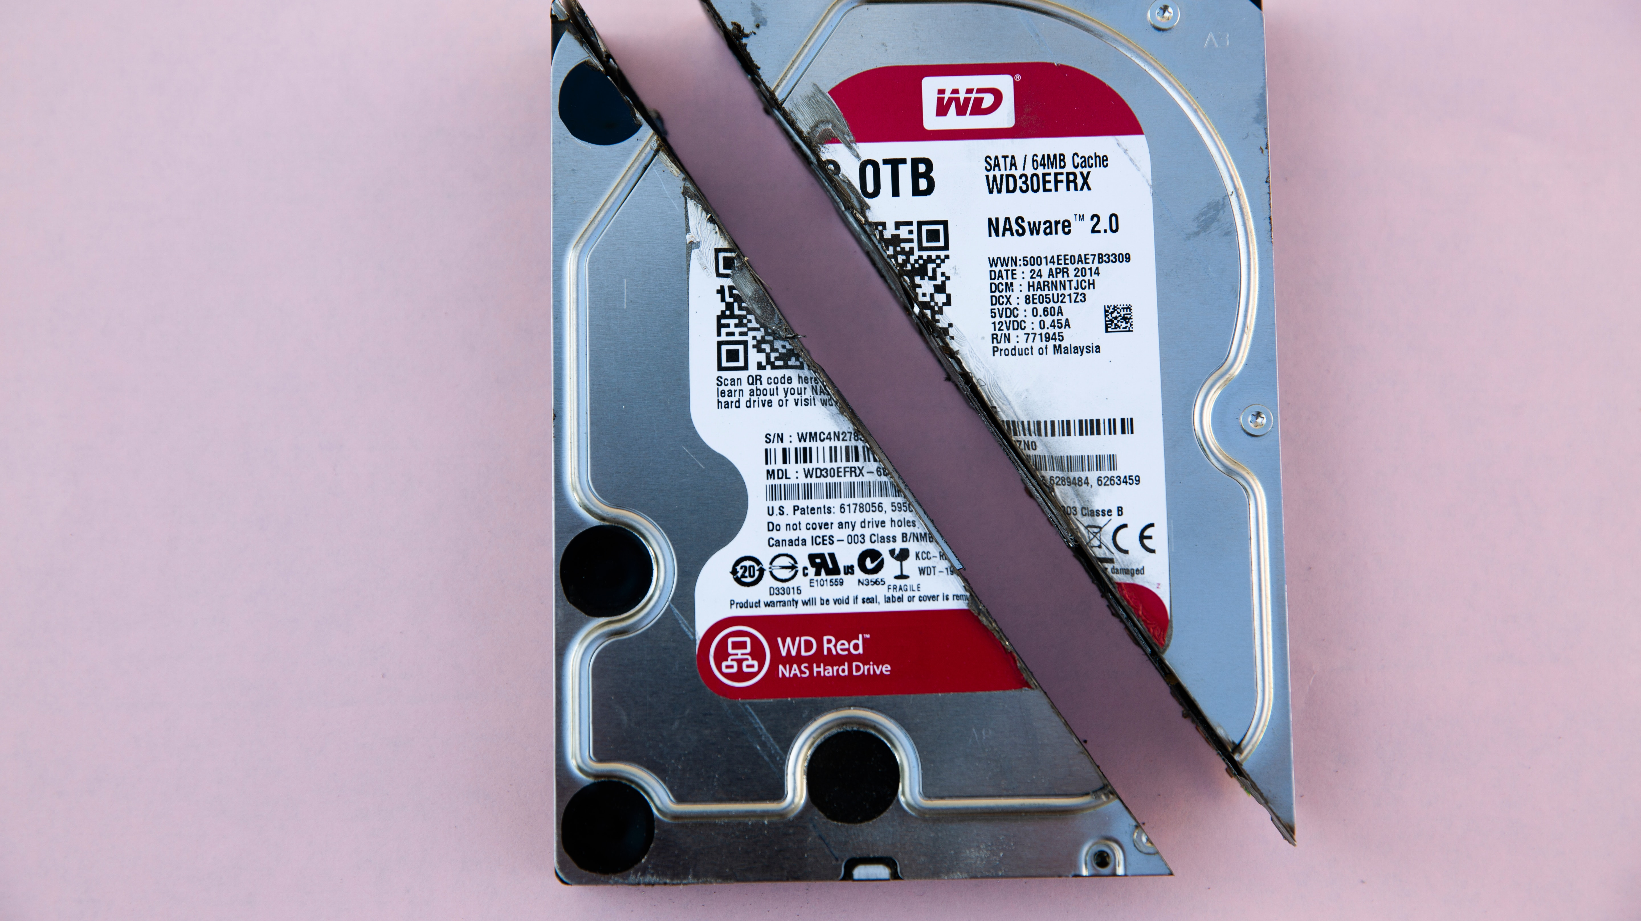
Backup strategies for Kafka

Slide 59
Backup strategy for Kafka
Most popular strategies:
Maintain second Kafka cluster, to which all topics get replicated using MirrorMaker
Dump topics to cloud storage, e.g. using S3 connector.
Problems:
Restoring Offsets for Customers
Zookeeper Backup

Slide 60
MirrorMaker
Synchronize Kafka topics between clusters
Disaster Recovery
Multi Data Center
Active / Passive cluster
Active / Active cluster

Slide 61
MirrorMaker - example
apiVersion: kafka.strimzi.io/v1alpha1
kind: KafkaMirrorMaker
metadata:
name: kafka-mirror-maker
namespace: kafka
spec:
version: 2.2.1
replicas: 1
consumer:
bootstrapServers: kafka-cluster-kafka-bootstrap.kafka:9092
groupId: test-id
producer:
bootstrapServers: kafka-cluster-backup-kafka-bootstrap.kafka:9092
whitelist: "kafka-topic"

Slide 62
Exercise 8 MirrorMaker

Slide 63

Topic partitions vs consuments

Slide 64
How to choose numer of partitions
Choosing the proper number of partitions for a topic is the key to achieving a high degree of parallelism with respect to writes to and reads and to distribute load. Evenly distributed load over partitions is a key factor to have good throughput (avoid hot spots). Making a good decision requires estimation based on the desired throughput of producers and consumers per partition.

Slide 65
How to choose numer of partitions
So a simple formula could be:
#Partitions = max(N_{P}, N_{C})
where:
N_{P} is the number of required producers determined by calculating: T_{T}/T_{P}
N_{C} is the number of required consumers determined by calculating: T_{T}/T_{C}
T_{T} is the total expected throughput for our system
T_{P} is the max throughput of a single producer to a single partition
T_{C} is the max throughput of a single consumer from a single partition

Slide 66
Key observations:
The number of partitions can be specified at topic creation time or later.
Increasing the number of partitions also affects the number of open file descriptors. So make sure you set file descriptor limit properly.
Reassigning partitions can be very expensive, and therefore it's better to over- than under-provision.
Changing the number of partitions that are based on keys is challenging

Slide 67
Key observations:
Reducing the number of partitions is not currently supported. Instead, create a new a topic with a lower number of partitions and copy over existing data.
Metadata about partitions are stored in ZooKeeper in the form of znodes. Having a large number of partitions has effects on ZooKeeper and on client resources:
You should not have more than 4000 partitions per broker and not more than 200,000 partitions in a cluster

Slide 68
Best practicies:
Unless you have architectural needs that require you to do otherwise, use random partitioning when writing to topics.
Understand the data rate of your partitions to ensure you have the correct retention space.

Slide 69

Thanks!

